Slide 1
TypeScript : All parts are good
Andriy Deren
CEO, Onlizer
a.deren@onlizer.com

Slide 2
TypeScript: Who, when and why?

Slide 3
JavaScript| Wide-spread development platform
Low entry threshold
Flexible and extensible language
Huge community and ecosystem
Only one language working native in-browser
Working practically everywhere now

Slide 4
JavaScript| Development challenges
Complicated inheritance and visibility paradigm
Dynamically typed: cure and curse
Transparent architecture design is hard to implement
Well-known design problems: global variables, spaghetti code, dependencies hell,
callbacks hell, 100500 lines scripts and many more
Huge, enterprise-oriented and full-JS projects are hard to implement
and painful to support

Slide 5
TypeScript| Historical retrospective
TypeScript was first made public in October 2012
Anders Hejlsberg, lead architect of C# and creator of Delphi and Turbo Pascal,
has worked on the development of TypeScript
Originated from the perceived shortcomings of JavaScript for the development of
large-scale applications
As TypeScript is a superset of JavaScript, any existing JavaScript programs
are also valid TypeScript programs.
Open-source + community support = fast growth

Slide 6
TypeScript| One year – four releases
1.8
1.7
1.6
JavaScript in TS projects + control flow analysis
1.5
Async/await on server + polymorphic ‘this’ types
Full ES2015 + React/JSX
Core ES2015 + Decorators

Slide 7
Language features

Slide 8
TypeScript| General features
Strong typing system + type annotations = static and compile time checking
Class-based inheritance system
Type inference
Visibility flags (public/private)
Interfaces, enums, tuples, unions
Optional properties, optional parameters, default parameters

Slide 9
TypeScript| Advanced features
Generics
Iterators (for.. of, for.. in) and Generators
Strings templating
Decorators
Build-in modular system
Supports build-in JS functions
Everything can be typed (thanks to *.d.ts)
Supports modern ES features now

Slide 10
TypeScript| Little sample
class Cat extends Animal implements ILazy {
private lifesCount: number;
constructor() {
super(); //calls super-class constructor
this.lifesCount = 9;
}
takeDamage(capacity: number): void {
super.takeDamage(capacity);
if (this.health <= 0)
this.lifesCount -= 1;
}
checkAlive(): boolean {
return this.lifesCount > 0;
}
sleep(): void {
if (this.health < 100)
this.health++;
}
}
class Animal {
constructor() {
this.health = 100;
this.name = "No name";
}
health: number;
name: string;
checkAlive(): boolean {
return this.health > 0;
}
takeDamage(capacity: number): void {
this.health -= capacity;
}
}
interface ILazy {
sleep(): void;
}

Slide 11
TypeScript| Iterators
An object is deemed iterable if it has an implementation for the Symbol.iterator property.
Build-in: Array, Map, Set, String, Int32Array, Uint32Array
let list = [4, 5, 6];
for (let i in list) {
console.log(i); // "0", "1", "2",
}
for (let i of list) {
console.log(i); // "4", "5", "6"
}
let pets = new Set(["Cat", "Dog", "Hamster"]);
pets["species"] = "mammals";
for (let pet in pets) {
console.log(pet); // "species"
}
for (let pet of pets) {
console.log(pet); // "Cat", "Dog", "Hamster"
}

Slide 12
TypeScript| Union types and type-guards
Sometimes our function can return result from specter of types but we prefer don’t use
build-in type any for many reasons. There we can use union types:
function getSmallPet(): Bird | Fish {
//creator logic here
}
But usage can be painful:
let pet = this.getSmallPet();
if ((<Fish>pet).swim) {
(<Fish>pet).swim();
}
else {
(<Bird>pet).fly();
}

Slide 13
TypeScript| Union types and type-guards
So we need reduce noise of types conversion and add type guard:
function isFish(pet: Fish | Bird): pet is Fish { //user defined type-guard
return (<Fish>pet).swim !== undefined;
}
if (isFish(pet)) { //no type-conversion needed
pet.swim();
} else {
pet.fly();
}
function isNumber(x: any): x is number { //typeof x usage
return typeof x === "number";
}
if (pet instanceof Fish) { //instanceof x usage
pet.swim();
}

Slide 14
TypeScript| Module system
General understanding: module is namespace
export const numberRegexp = /^[0-9]+$/; //inline export
class ZipCodeValidator implements StringValidator {
isAcceptable(s: string) {
return s.length === 5 && numberRegexp.test(s);
}
}
export { ZipCodeValidator }; //single export
export { ZipCodeValidator as mainValidator }; //export with renaming
Import examples
import { ZipCodeValidator } from "./ZipCodeValidator"; //single import
let myValidator = new ZipCodeValidator();
import * as validator from "./ZipCodeValidator"; //module import
let myValidator = new validator.ZipCodeValidator();

Slide 15
TypeScript| Decorators
A Decorator is a special kind of declaration that can be attached to a class declaration, method, accessor, property, or parameter. Decorator expression must evaluate to a function that will be called at runtime with information about the decorated declaration.
@sealed
class ClassToSeal{
//some implementation
}
function sealed(constructor: Function) {
Object.seal(constructor);
Object.seal(constructor.prototype);
}

Slide 16
Development ecosystem

Slide 17








Development| Tools
Visual Studio
Sublime Text
Atom
WebStorm
Visual Studio Code
Eclipse
Emacs
Vim

Slide 18
Development| Community
GitHub
3,800+ commits in the last year
1,200+ forks
10,000+ stars
Stack Overflow
8,000+ questions, up more than 2x in the last year
Stack Overflow
1,600+ .d.ts declaration files, up 2x in the last year

Slide 19
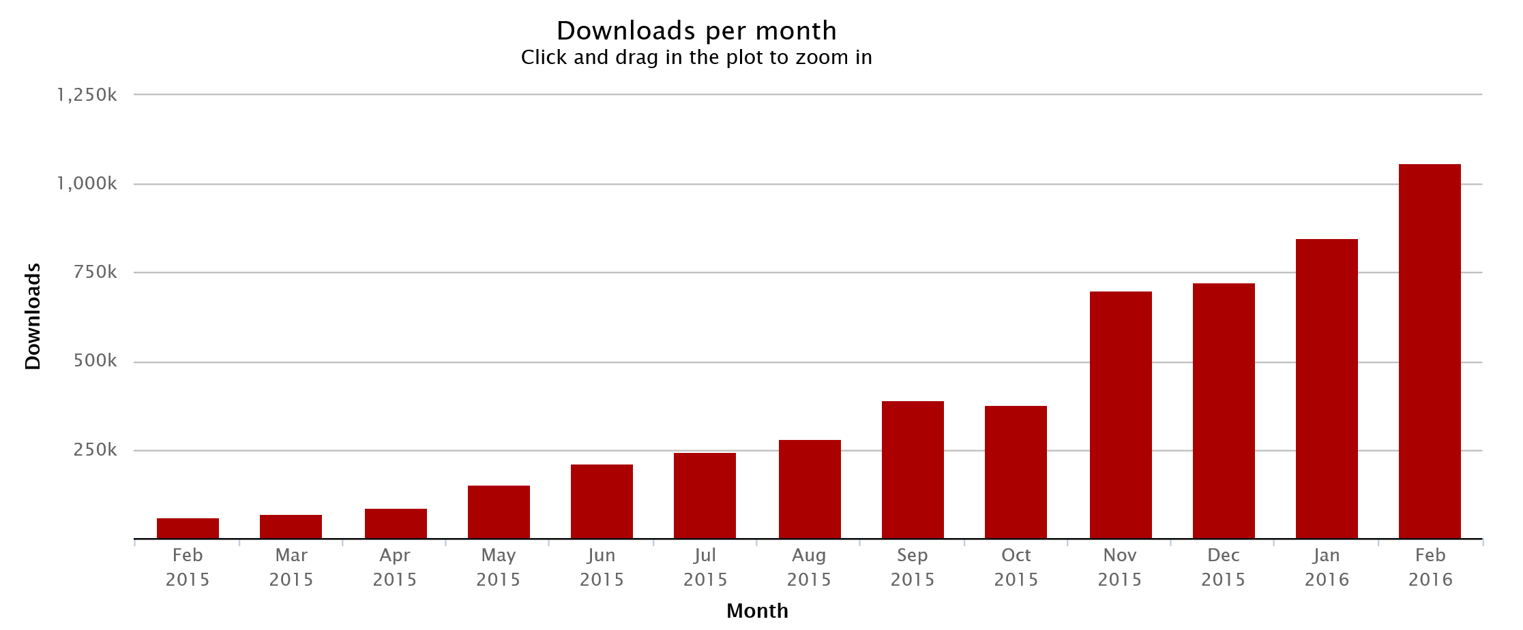
Development| Adoption

Slide 20





Development| Frameworks
“With TypeScript, several of our team members have said things like “I now actually understand most of our own code!” because they can easily traverse it and understand relationships much better.”
-- Brad Green, Engineering Director at Google
“One of Ionic's main goals is to make app development as quick and easy as possible, and the tooling support TypeScript gives us with autocompletion, type checking and source documentation really aligns with that.”
-- Tim Lancina, Tooling Developer at Ionic
“TypeScript helped us to reuse the team’s knowledge and to keep the same team velocity by providing the same excellent developer experience as C# ... A huge improvement over plain JavaScript.”
-- Valio Stoychev, PM Lead NativeScript
“By combining Aurelia with TypeScript for modern web, mobile and desktop development, we've seen what is perhaps the most beautiful and elegant app development workflow to date.”
-- Rob Eisenberg, Architect - Aurelia
“TypeScript has helped ensure that Dojo 2 will be built on rock solid foundations, which will make enterprise development better. TS gives us all the benefits of ES6, plus more productivity, … and responsive support from the TypeScript team ”
-- Dylan Schiemann, Co-founder - Dojo Toolkit, CEO - SitePen

Slide 21































Slide 22
Real-life experience

Slide 23
TypeScript| Best for…
Developers
Junior Web-developers to simplify learning and create better code
Experienced JS-developers – for productivity, fun and profit
As second language or migration for C#, Java, C++, Objective-C developers

Slide 24
TypeScript| Best for…
Projects
Any large ES-based project
Full-JS stack Web solutions (Node.js + Angular, React, Durandal, Aurelia, etc.)
Mixed-stack solutions for teams with experience in C#, Java, C++
Mobile solutions
IoT solutions

Slide 25
TypeScript| Where to start
TypeScript official site http://www.typescriptlang.org/
TypeScript Jump Start https://channel9.msdn.com/Blogs/MostafaElzoghbi
/TypeScript-Jump-Start1
What's New in TypeScript? https://channel9.msdn.com/events/Build/2016/B881
Typescript with Angular https://channel9.msdn.com/events/JavaScript-Webinar-Series
/TypeScript--Angular/TypeScript--Angular

Slide 26
Many thanks for attention!

